Slide 1
Logic circuits
Mack 2021

Slide 2
Background
Computers often chain logic gates together, by taking the output from one gate and using it as the input to another gate. We call that a logic circuit.
Circuits enables computers to do more complex operations than they could accomplish with just a single gate.
The smallest circuit is a chain of 2 logic gates.

Slide 3

Consider this circuit:
Notes:
Inputs A and B first go through an AND gate. Then the output of that gate goes through an OR gate, combined with another input, C.
Now interesting things happen based on which inputs are 0 or 1.

Slide 4

Let's set everything to on at first - all inputs are 1 or "true":
Notes:
The output is also 1 or "true", since 1 AND 1 is 1, and 1 OR 1 is also 1.

Slide 5

What if we set inputs A and B to off, and keep C on?
Notes:
In this case, the output is still 1! That's because the final step is an OR gate, so it only needs one of the inputs to be on for it to output a 1.

Slide 6

CHECK YOUR UNDERSTANDING
Now you try it. What do you think this chain will output if we set inputs A and B to 1 and set input C to 0?
Notes:
🍐 This is a Pear Deck Text Slide
🍐 To edit the type of question, go back to the "Ask Students a Question" in the Pear Deck sidebar.

Slide 7

CHECK YOUR UNDERSTANDING
Try one more combination. What if we set input A to 1, input B to 0, and input C to 0?
Notes:
🍐 This is a Pear Deck Text Slide
🍐 To edit the type of question, go back to the "Ask Students a Question" in the Pear Deck sidebar.

Slide 8
Thoughts...
If you're struggling to figure out what a circuit outputs, try tracing it one gate at a time. Get out a pencil and paper, start on the first gate, write its output over the wire, then look at the next gate. Theoretically, you could figure out the output for a chain of gates that's hundreds of gates long! You probably have more exciting things to do though, so it's a good thing that we typically have computers to do that for us.

Slide 9
Practice

Slide 10

The diagram below shows a circuit where an OR gate leads to an AND gate. The circuit has three inputs (A, B, C) and a single output.
If the output is 1 and input C is 1, what are the possible states of inputs A and B?
Notes:
🍐 This is a Pear Deck Multiple Choice Slide. Your current options are: A: Both inputs A and B are 1, B: Input A is 0, input B is 1, C: Both inputs A and B are 0, D: Input A is 1, input B is 0,
🍐 To edit the type of question or choices, go back to the "Ask Students a Question" in the Pear Deck sidebar.
👁️Note that there may be multiple answers to this question.

Slide 11
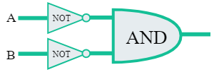
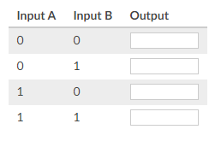
Fill out the truth table for the circuit by entering a 0 or 1 in the output column for each row:
The following circuit takes two inputs, sends each input through a NOT gate, and then sends those outputs through an AND gate. This circuit is logically equivalent to the NOR logic gate, a common gate in computers.
Notes:
🍐 This is a Pear Deck Text Slide
🍐 To edit the type of question, go back to the "Ask Students a Question" in the Pear Deck sidebar.
Fill out the truth table for the circuit by entering a 0 or 1 in the output column for each row:

Slide 12
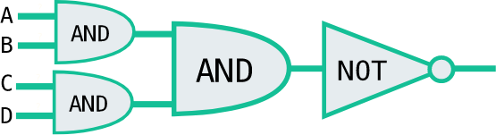
The diagram below shows a circuit with four gates, where the output from two AND gates are sent into a third AND gate, and the output from that gate is sent into a NOT gate. The circuit has four inputs (A, B, C, D).
If the final output is 000, what are possible states of inputs A, B, C, and D?
Notes:
🍐 This is a Pear Deck Multiple Choice Slide. Your current options are: A: A = 0, B = 0, C = 0, D = 0, B: A = 1, B = 1, C = 0, D = 1, C: A = 0, B = 1, C = 0, D = 1, D: A = 1, B = 0, C = 1, D = 0, E: A = 1, B = 1, C = 1, D = 1,
🍐 To edit the type of question or choices, go back to the "Ask Students a Question" in the Pear Deck sidebar.

Slide 13
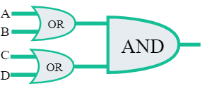
The diagram below shows a circuit with three gates, where the output from two OR gates are sent into a final AND gate. The circuit has four inputs (A, B, C, D), two for each OR gate.
If the final output is 0, what is a possible state of the inputs A/B/C/D?
Notes:
🍐 This is a Pear Deck Multiple Choice Slide. Your current options are: A: A = 0, B = 1, C = 0, D = 1, B: A = 0, B = 1, C = 0, D = 0, C: A = 1, B = 0, C = 1, D = 0, D: A = 1, B = 1, C = 1, D = 1,
🍐 To edit the type of question or choices, go back to the "Ask Students a Question" in the Pear Deck sidebar.

